Slide 1
TOEFL iBT Course Sample Slides

Slide 2
TOEFL iBT overview
Reading (3-4 Reading Passages) 60-80 minutes
Listening (6-9 Listening Passages) 60-90 minutes
Break 10 minutes
Speaking (6 Questions) 20 minutes
Writing (2 Questions-Tasks-) 55 minutes

Slide 3
Speaking QUESTION 5: Sample 1
Listen to part of a conversation between two students.

Slide 4
Speaking QUESTION 5: Sample 1
The students are discussing a problem and two possible solutions. Briefly describe the problem then state which of the two solutions you recommend and explain why.
Preparation Time: 20 Seconds
Response Time: 60 Seconds

Slide 5
Speaking QUESTION 5: Sample 1
A Sample Response
The man’s problem is that he doesn’t understand the formulas and functions in the calculus class. To make the matters worse, the final exam is at hand.
(10-15 Sec)
The woman suggests that he either take a tutor in the math building or form a study group. (10-15 sec)

Slide 6
Speaking QUESTION 5: Sample 1
If I were the man, I would choose the first solution. The second solution is not good because forming a study group is a big waste of time; as the man says usually group members end up talking about irrelevant points. Although taking a tutor is costly, the man can be sure that PhD students are knowledgeable enough to help him with the materials and the final exam.

Slide 7
Listening: Question Types
COMPREHENSION | PRACTICAL UNDERSTANDING
Main Idea Detail Inference Content Questions | Attitude Purpose (Function) Organization

Slide 8
Listening: Main Idea Questions
The first question
Gist of the listening
The purpose of conversation:
Asking for help on a problem
Becoming familiar with campus policies
The purpose of lectures/discussions:
To define, to talk about causes/ effects, compare, contrast, refute, describe, classify, etc.

Slide 9
Listening Tips
You are supposed to jot down key words to help you answer questions. DO NOT write down everything: it might make you fail to comprehend.
Pay attention to the first 30-60 gold seconds of the passage either in conversations or in lectures:[find the KEY to solve the puzzle!] you need to be patient enough to get the gist of the passage and then jot it down.

Slide 10
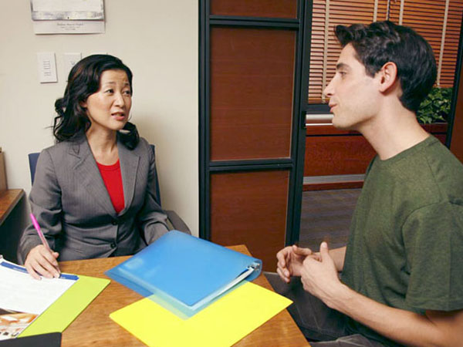
Listening Practice 1
Listen to the conversation between a student and his psychology professor. We will listen to the listening twice.

Slide 11
Notes
Man | Woman
Research proj. clarify 2 obs+note Example Pre-op Play pretend> toy car/ bridge Not demonstrate? Where child? | +Observation> synthes. read & observ. Paper 1 child > 2 1st obs> go textbook/lib> stage develop.> 2nd obs>exhibit behave 4-yr child Piaget> stage? 1.Lg mature 2. memory imagin develop 3. egocentric OK> compare what obs & read Edu secretary list contacts> families help

Slide 12
Transcript(NOT AVAILABLE ON THE TEST!)
Professor:
Good afternoon, Alex, can I help you with something?
Student:
Well, I want to talk with you about the research project you have assigned today. I um…I hope you could clarify a few things for me.
Professor:
I’ll certainly try….

Slide 13
Listening Practice 1
1. Why does the student go to see the professor?
To report on the research he has done
To ask for permission to observe a class
To get help understanding an assignment
To ask a question on recent test

Slide 14
Writing an introduction
Thesis statement:
In your thesis statement -as the last part of your introduction, you are supposed to state your position clearly in order to give the reader an overview of what you will discuss in your body paragraph.
It may have two major parts:
1. stating your positions
2. stating your reasons(optional)
Keep it focused, concise and pertinent

Slide 15
Writing Sample Topic: Technology has made our lives better. Do you agree or disagree?
In modern era, advances in technology are altering all aspects of people’s lives dramatically. In actuality, it has long been believed that technology would facilitate human being’s life. However, recently this issue has engendered many controversies among academicians. While many are adamant that technology has facilitated our lives, some believe that a myriad of factors should be taken into consideration to examine the effects of technology on our lives and that the adverse effects of technology on our lives should be regarded meticulously. I believe that technology did not stand the test of time. The following paragraphs will illustrate my perspective.

Slide 16
READING
Vocabulary in context question; one of the most common and easy question types on the TOEFL. You can identify them because they ask for the meaning or definition of a word, typically shaded in gray.

Slide 17
READING
1. Go back to the passage and read a few lines before and after the word in question.
2. Come up with your own word for the shaded word based on the clues in the sentences.
3. Return to the answer c:hoices and eliminate any choices that are not supported by any words or phrases from the passage or are dictionary definitions of the word, but are incorrect in the context of the passage

Slide 18
READING
1. The word impetus in the passage is closest in meaning to
return
opportunity
stimulus
obstacle

Slide 19
READING
In the fourteenth century, a number of political developments cut Europe's overland trade routes to southern and eastern Asia, with which Europe had had important and highly profitable commercial ties since the twelfth century. This development, coming as it did when the bottom had fallen out of the European economy, provided an impetus to a long-held desire to secure direct relations with the East by establishing a sea trade.

Slide 20
READING
5. The word dramatically in the passage is closest in meaning to
artificially
greatly
immediately
regularly

Slide 21
READING
Spices were the most sought-after commodities. Spices not only dramatically improved the taste of the European diet but also were used to manufacture perfumes and certain medicines. But even high-priced commodities like spices had to be transported in large bulk in order to justify the expense and trouble of sailing around the African continent all the way to India and China.

Slide 22
READING
10. The word refined in the passage is closest in meaning to
completed
improved
drawn
checked

Slide 23
READING
By the early thirteenth century, western Europeans had also developed and put into use the magnetic compass, which helped when clouds obliterated both the Sun and the stars. Also beginning in the thirteenth century, there were new maps refined by precise calculations and the reports of sailors that made it possible to trace one's path with reasonable accuracy.

Slide 24
Vocabulary Word 5: decline
Transitive: refuse: reject: to turn down:
Intransitive: lessen: decrease: diminish: deteriorate
There has been a decline in the size of families.
rapid/sharp/steep/dramatic decline
a rapid decline in unemployment
Spending on information technology has declined.
Car sales have declined by a quarter.
Mary declined Jay's invitation to dinner.
Her health has been declining progressively for several months.

Slide 25
Pop Quiz
Define the bold-faced words.
1. Ed asked me to run the new division for them, but I declined.
2. The crowd gave a spontaneous cheer when the news was announced.
3. The California state flag depicts a grizzly bear.
4. Even an expert would find it hard to distinguish between the original painting and the copy.
5. Candidates must make decisions quickly, sometimes with little or contradictory information.

Slide 26
Word 6: deplete
Consume: empty: drain: lessen: reduce
Salmon populations have been severely depleted.
CFC is just one chemical that depletes the ozone layer.
Over the last few years, rainforests have been steadily depleted.

Slide 27
Word 7:abolish
Cancel: end: eliminate: eradicate: revoke
Slavery was abolished in the US in the 19th century.
He served over 27 years in prison for fighting to abolish white-only rule.
Welfare programs cannot be abolished that quickly.
Demonstrations have led to the abolition of the rules.

Slide 28
Grammar Noun Clause as the Object of a Sentence
I do not know how long she was there.
Nobody told me when they would arrive.
To introduce the noun clause as the object of the sentence, these expressions are often used.
I don’t know…..
He didn’t say…..
I didn’t ask her…..
They didn’t explain….
I have no idea why…
I can’t tell you if….
She didn’t tell me whether…..

Slide 29
Grammar Noun Clause as the Object of a Preposition
Everyone believes in whatever Tony says.
I never think about how I will pay my bills.
I can’t rely on what you tell me.

Slide 30
Grammar: Noun Clause as Adjective Complement
I am sure that he’ll succeed.
I am convinced that she’s unhappy.
Subject+ Verb+ (that)+ Noun clause
We are aware that……
I am sure that….
He is certain that…..
I am positive that…..
She is confident that…..
I am afraid that…..

Slide 31
-ever Words in Noun Clauses
Whoever-Whomever- Whichever- Whenever- However
Whoever does the assignment will be praised.
I will invite whomever you like.
However you cook the meat is all right with me.
You should do whatever seems best to tackle the problem.

Slide 32
Subjunctive Verbs
The doctor advised that she remain in the hospital.
She recommended that he return in the morning.
She suggested that he be punctual.
He proposed that we not work on that project.
He advised that Sheila should remain in hospital. (Informal)
ALSO>> It is important that he do the class activities regularly.

